Slide 1
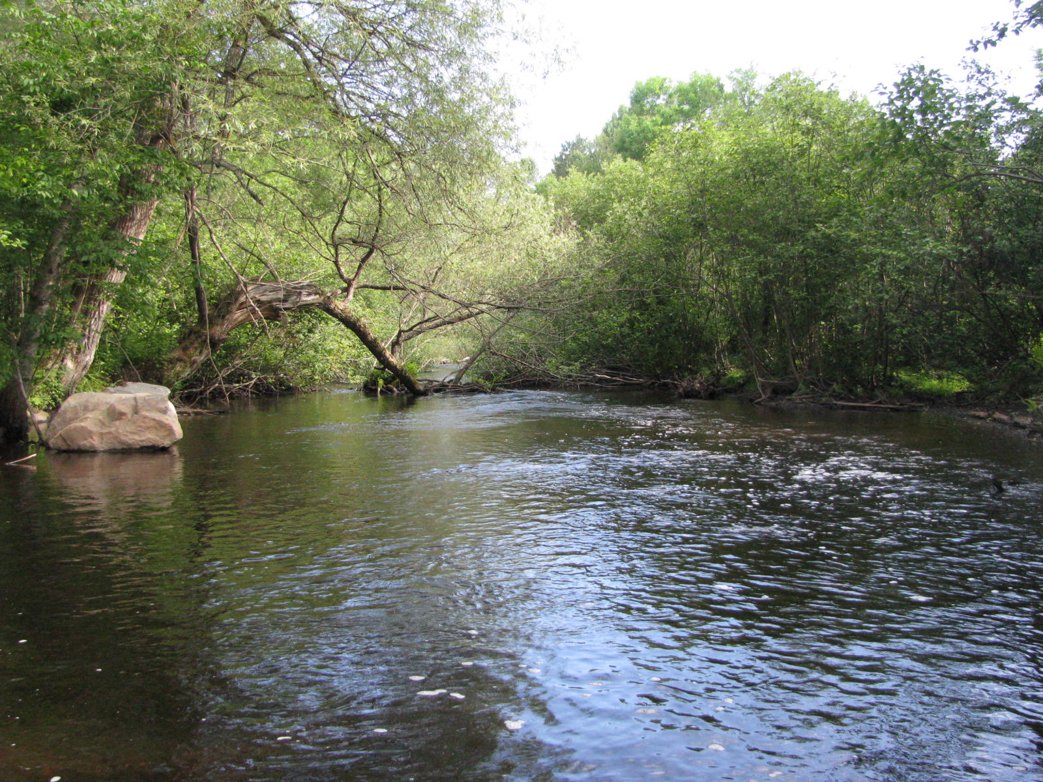
Before
Pictured is a natural log jam, at the start of the project. Depth of water is about one foot. Boulders to the left will be placed in the created pool.

Slide 2
After
Standing on created point bar. Picture showing pool 3-4 feet deep.

Slide 3
Before
Long Run 2-2.5 feet deep.

Slide 4
After
Long run dug to about 4 feet tapering up to created point bar on the right.

Slide 5
Before
Depth about 4-6 inches. Rocks to be placed shown on right.

Slide 6
After
No digging in this section, only rocks randomly installed.

Slide 7
Before
Picture showing old bridge abutments holding back about a foot of water. Boulders to be installed above bridge also shown.

Slide 8
After
Long run dug about 3 feet deep above bridge abutments. Dug 4-5 foot pool below abutments. Picture taken on island created below abutments.

